Slide 1
THE MINIMUM SPANNING TREE

Slide 2
Definition
A Minimum Spanning Tree (MST) is a subgraph of an undirected graph such that the subgraph spans (includes) all nodes, is connected, is acyclic, and has minimum total edge weight

Slide 3
Algorithm Characteristics
Both Prim’s and Kruskal’s Algorithms work with undirected graphs
Both work with weighted and unweighted graphs but are more interesting when edges are weighted
Both are greedy algorithms that produce optimal solutions

Slide 4
Prim’s Algorithm
Similar to Dijkstra’s Algorithm except that d_{v} records edge weights, not path lengths

Slide 5
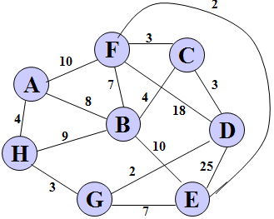
Example of Prim’s Algorithm-

Slide 6
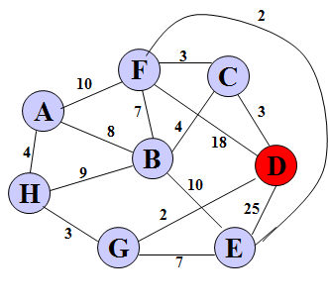
Step-1

Slide 7
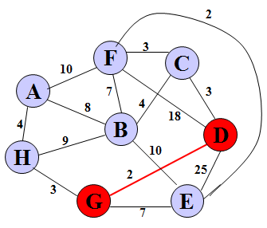
Step-2

Slide 8
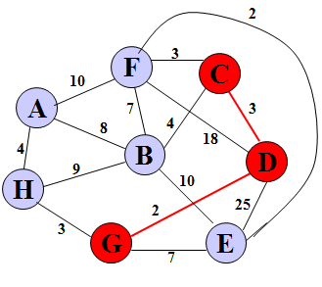
Step-3

Slide 9
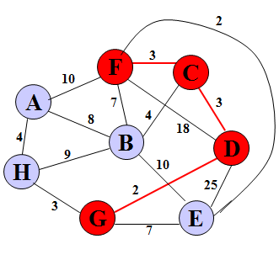
Step-4

Slide 10
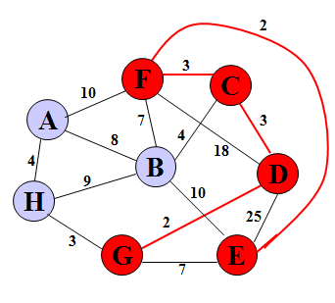
Step-5

Slide 11
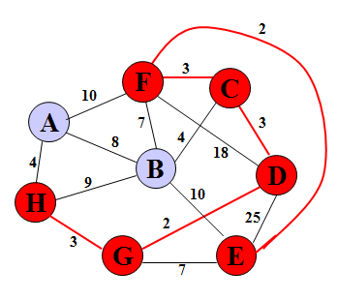
Step-6

Slide 12
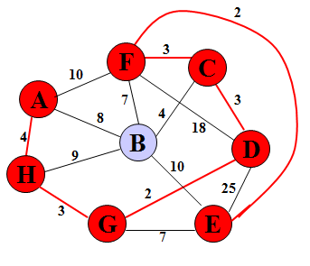
Step-7

Slide 13
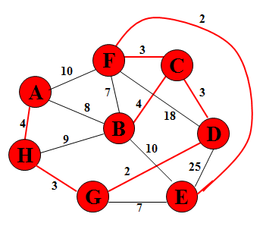
Step-8

Slide 14
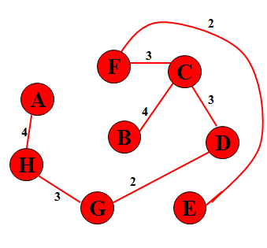
Step-9

Slide 15
Kruskal’s Algorithm
Work with edges, rather than nodes
Two steps:
Sort edges by increasing edge weight
Select the first |V| – 1 edges that do not generate a cycle

Slide 16
Walk-Through
Consider an undirected, weight graph
F
3
C
10
A
4
3
8
4
5
B
6
D
4
4
H
2
1
3
G
E
3

Slide 17
the edges by increasing edge weightSort
F
3
C
edge | d_{v}
(D,E) | 1
(D,G) | 2
(E,G) | 3
(C,D) | 3
(G,H) | 3
(C,F) | 3
(B,C) | 4
edge | d_{v}
(B,E) | 4
(B,F) | 4
(B,H) | 4
(A,H) | 5
(D,F) | 6
(A,B) | 8
(A,F) | 10
10
A
4
3
8
4
5
B
6
D
4
4
H
2
1
3
G
E
3

Slide 18
Select first |V|–1 edges which do not generate a cycle
F
3
C
edge | d_{v}
(D,E) | 1 | √
(D,G) | 2
(E,G) | 3
(C,D) | 3
(G,H) | 3
(C,F) | 3
(B,C) | 4
edge | d_{v}
(B,E) | 4
(B,F) | 4
(B,H) | 4
(A,H) | 5
(D,F) | 6
(A,B) | 8
(A,F) | 10
10
A
4
3
8
4
5
B
6
D
4
4
H
2
1
3
G
E
3

Slide 19
Select first |V|–1 edges which do not generate a cycle
F
3
C
edge | d_{v}
(D,E) | 1 | √
(D,G) | 2 | √
(E,G) | 3
(C,D) | 3
(G,H) | 3
(C,F) | 3
(B,C) | 4
edge | d_{v}
(B,E) | 4
(B,F) | 4
(B,H) | 4
(A,H) | 5
(D,F) | 6
(A,B) | 8
(A,F) | 10
10
A
4
3
8
4
5
B
6
D
4
4
H
2
1
3
G
E
3

Slide 20
Select first |V|–1 edges which do not generate a cycle
F
3
C
edge | d_{v}
(D,E) | 1 | √
(D,G) | 2 | √
(E,G) | 3 | χ
(C,D) | 3
(G,H) | 3
(C,F) | 3
(B,C) | 4
edge | d_{v}
(B,E) | 4
(B,F) | 4
(B,H) | 4
(A,H) | 5
(D,F) | 6
(A,B) | 8
(A,F) | 10
10
A
4
3
8
4
5
B
6
D
4
4
H
2
1
3
G
E
3
Accepting edge (E,G) would create a cycle

Slide 21
Select first |V|–1 edges which do not generate a cycle
F
3
C
edge | d_{v}
(D,E) | 1 | √
(D,G) | 2 | √
(E,G) | 3 | χ
(C,D) | 3 | √
(G,H) | 3
(C,F) | 3
(B,C) | 4
edge | d_{v}
(B,E) | 4
(B,F) | 4
(B,H) | 4
(A,H) | 5
(D,F) | 6
(A,B) | 8
(A,F) | 10
10
A
4
3
8
4
5
B
6
D
4
4
H
2
1
3
G
E
3

Slide 22
Select first |V|–1 edges which do not generate a cycle
F
3
C
edge | d_{v}
(D,E) | 1 | √
(D,G) | 2 | √
(E,G) | 3 | χ
(C,D) | 3 | √
(G,H) | 3 | √
(C,F) | 3
(B,C) | 4
edge | d_{v}
(B,E) | 4
(B,F) | 4
(B,H) | 4
(A,H) | 5
(D,F) | 6
(A,B) | 8
(A,F) | 10
10
A
4
3
8
4
5
B
6
D
4
4
H
2
1
3
G
E
3

Slide 23
Select first |V|–1 edges which do not generate a cycle
F
3
C
edge | d_{v}
(D,E) | 1 | √
(D,G) | 2 | √
(E,G) | 3 | χ
(C,D) | 3 | √
(G,H) | 3 | √
(C,F) | 3 | √
(B,C) | 4
edge | d_{v}
(B,E) | 4
(B,F) | 4
(B,H) | 4
(A,H) | 5
(D,F) | 6
(A,B) | 8
(A,F) | 10
10
A
4
3
8
4
5
B
6
D
4
4
H
2
1
3
G
E
3

Slide 24
Select first |V|–1 edges which do not generate a cycle
F
3
C
edge | d_{v}
(D,E) | 1 | √
(D,G) | 2 | √
(E,G) | 3 | χ
(C,D) | 3 | √
(G,H) | 3 | √
(C,F) | 3 | √
(B,C) | 4 | √
edge | d_{v}
(B,E) | 4
(B,F) | 4
(B,H) | 4
(A,H) | 5
(D,F) | 6
(A,B) | 8
(A,F) | 10
10
A
4
3
8
4
5
B
6
D
4
4
H
2
1
3
G
E
3

Slide 25
Select first |V|–1 edges which do not generate a cycle
F
3
C
edge | d_{v}
(D,E) | 1 | √
(D,G) | 2 | √
(E,G) | 3 | χ
(C,D) | 3 | √
(G,H) | 3 | √
(C,F) | 3 | √
(B,C) | 4 | √
edge | d_{v}
(B,E) | 4 | χ
(B,F) | 4
(B,H) | 4
(A,H) | 5
(D,F) | 6
(A,B) | 8
(A,F) | 10
10
A
4
3
8
4
5
B
6
D
4
4
H
2
1
3
G
E
3

Slide 26
Select first |V|–1 edges which do not generate a cycle
F
3
C
edge | d_{v}
(D,E) | 1 | √
(D,G) | 2 | √
(E,G) | 3 | χ
(C,D) | 3 | √
(G,H) | 3 | √
(C,F) | 3 | √
(B,C) | 4 | √
edge | d_{v}
(B,E) | 4 | χ
(B,F) | 4 | χ
(B,H) | 4
(A,H) | 5
(D,F) | 6
(A,B) | 8
(A,F) | 10
10
A
4
3
8
4
5
B
6
D
4
4
H
2
1
3
G
E
3

Slide 27
Select first |V|–1 edges which do not generate a cycle
F
3
C
edge | d_{v}
(D,E) | 1 | √
(D,G) | 2 | √
(E,G) | 3 | χ
(C,D) | 3 | √
(G,H) | 3 | √
(C,F) | 3 | √
(B,C) | 4 | √
edge | d_{v}
(B,E) | 4 | χ
(B,F) | 4 | χ
(B,H) | 4 | χ
(A,H) | 5
(D,F) | 6
(A,B) | 8
(A,F) | 10
10
A
4
3
8
4
5
B
6
D
4
4
H
2
1
3
G
E
3

Slide 28
Select first |V|–1 edges which do not generate a cycle
F
3
C
edge | d_{v}
(D,E) | 1 | √
(D,G) | 2 | √
(E,G) | 3 | χ
(C,D) | 3 | √
(G,H) | 3 | √
(C,F) | 3 | √
(B,C) | 4 | √
edge | d_{v}
(B,E) | 4 | χ
(B,F) | 4 | χ
(B,H) | 4 | χ
(A,H) | 5 | √
(D,F) | 6
(A,B) | 8
(A,F) | 10
10
A
4
3
8
4
5
B
6
D
4
4
H
2
1
3
G
E
3

Slide 29
Select first |V|–1 edges which do not generate a cycle
F
3
C
edge | d_{v}
(D,E) | 1 | √
(D,G) | 2 | √
(E,G) | 3 | χ
(C,D) | 3 | √
(G,H) | 3 | √
(C,F) | 3 | √
(B,C) | 4 | √
edge | d_{v}
(B,E) | 4 | χ
(B,F) | 4 | χ
(B,H) | 4 | χ
(A,H) | 5 | √
(D,F) | 6
(A,B) | 8
(A,F) | 10
A
3
4
5
B
D
H
2
1
}
3
G
E
not
considered
Done
Total Cost = Σ d_{v} = 21

Slide 30
THANK YOU

